Slide 1




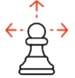


Trust My Identity
idea
problem
solution
solving Track 1 – Identity Management and APIs
while dabbling in Track 3 – Data Aggregation and Linkage
brought to you by Team TMI
opportunity
team
next up
@TCS @BurstIQ #DCblockchain

Slide 2






idea
inaccurate
information
cumbersome processes
problem
Payer have non-standard provider data structures-Legacy systems store data in multiple disconnected databases
Latency in updates
Complex and dynamic data
solution
opportunity
team
limited sharing
Multiple versions of data
Need based siloed data
next up
@TCS @BurstIQ #DCblockchain

Slide 3






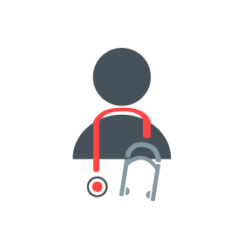

idea
problem
solution
opportunity
What did we use?
How do we manage identity?
How do we link data?
IPFS
Monax Blockchain (Ethereum + Tendermint)
BigChain DB
(BFT + NoSQL DB)
Manage attestation by running a smart contract system based on DOUG
Enforce digital signatures for persistent Primary Source Verification
Consensus-controlled authority
Linked payloads in BigChain DB
Split data from the blockchain with pointers
team
next up
@TCS @BurstIQ #DCblockchain

Slide 4











1
6
idea
(IPFS)
[physician]
problem
2
3
[payer]
(IPFS)
solution
4
5
opportunity
(IPFS)
[licensing]
team
next up
(BigChain)
(BigChain)
[blockchain]
@TCS @BurstIQ #DCblockchain

Slide 5
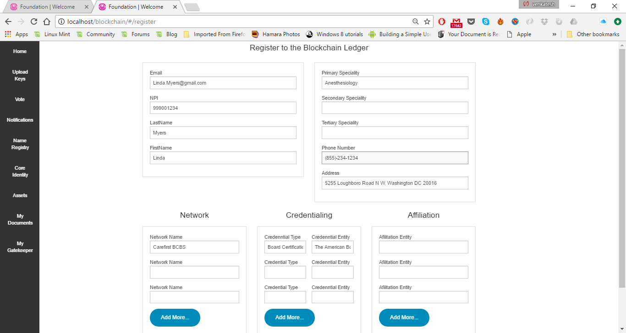
1
Physician creates a profile
idea
problem
solution
opportunity
team
next up
@TCS @BurstIQ #DCblockchain

Slide 6
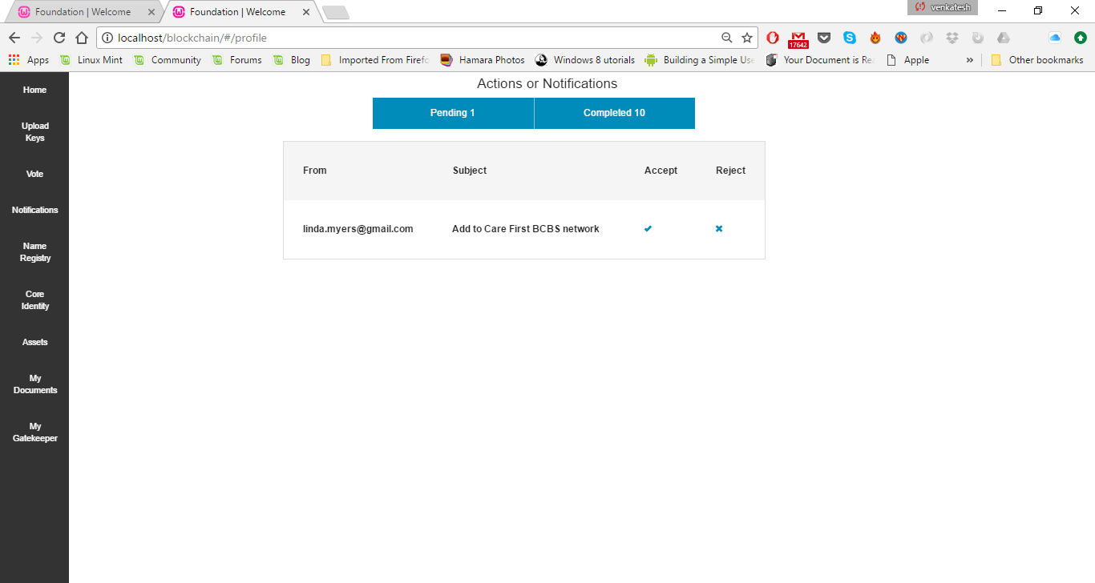
2
Payer receives a trigger to verify network affiliation
idea
problem
solution
opportunity
team
next up
@TCS @BurstIQ #DCblockchain

Slide 7

3
Payer certifies network affiliation
idea
problem
solution
opportunity
team
next up
@TCS @BurstIQ #DCblockchain

Slide 8
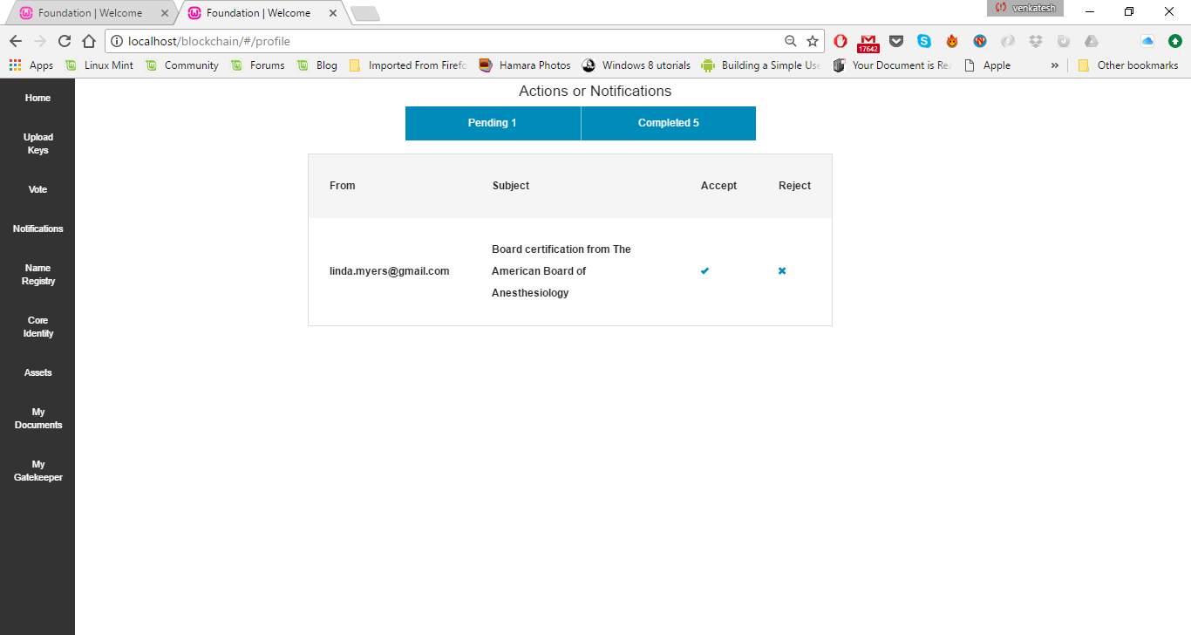
4
Board receives a trigger to verify clinical specialty
idea
problem
solution
opportunity
team
next up
@TCS @BurstIQ #DCblockchain

Slide 9

5
Board rejects clinical specialty
idea
problem
solution
opportunity
team
next up
@TCS @BurstIQ #DCblockchain

Slide 10


6
Physician profile is update + Physician is notified of attestations
idea
problem
solution
opportunity
team
next up
@TCS @BurstIQ #DCblockchain

Slide 11




 | [patient] | [physician] | [practices] | [payer] | [licensing] | [regulatory]
Distributed Provider Directory drives
Accurate provider information | ✓ | ✓ | ✓ | ✓ | ✓ | ✓
Faster credential verification |  | ✓ | ✓ | ✓ | ✓ | ✓
Asynchronous + real-time updates by multiple entities |  | ✓ | ✓ | ✓
Patient-centered care options | ✓ | ✓ | ✓ | ✓
Interoperability at scale, on steroids | ✓ | ✓ | ✓ | ✓ | ✓ | ✓
… and facilitates
Transition to value-based payment models | ✓ | ✓ | ✓ | ✓ |  | ✓
Improved care coordination | ✓ | ✓ | ✓ | ✓ |  | ✓
Easier population health analytics + reporting | ✓ | ✓ | ✓ | ✓ |  | ✓
$1-2B
idea
problem
solution
opportunity
team
next up
@TCS @BurstIQ #DCblockchain

Slide 12



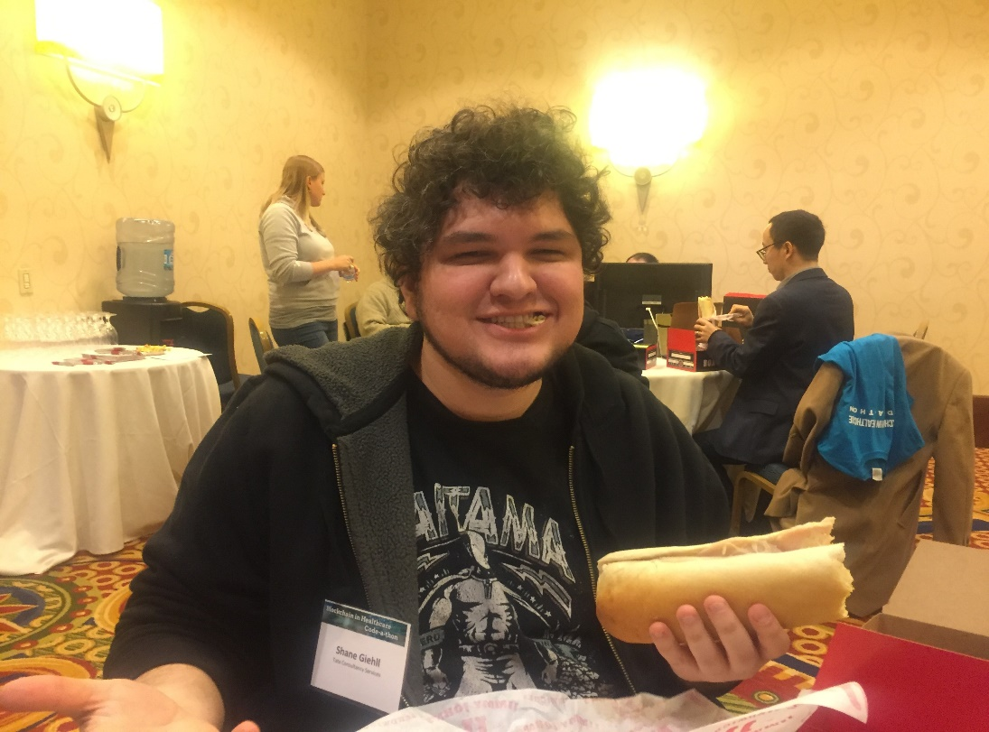




idea
problem
solution
Uppi
Reddy
Andreas Freund
Venky Raghunathan
Shane
Giehll
Lily
Bragg
opportunity
team
next up
@TCS @BurstIQ #DCblockchain

Slide 13


idea
1
Include blockchain as a recommended tech in the design + implementation of distributed provider directories
problem
2
Encourage recipients of CMS funding to invest in developing distributed provider directories
solution
opportunity
3
Provide education on use cases + advantages of blockchain
team
next up
@TCS @BurstIQ #DCblockchain

Slide 14

Trust My Identity
idea
solving Track 1 – Identity Management and APIs
while dabbling in Track 3 – Data Aggregation and Linkage
brought to you by Team TMI
problem
solution
opportunity
team
Uppi
Reddy
Andreas Freund
Venky Raghunathan
Shane
Giehll
Lily
Bragg
next up
@TCS @BurstIQ #DCblockchain

